Slide 1

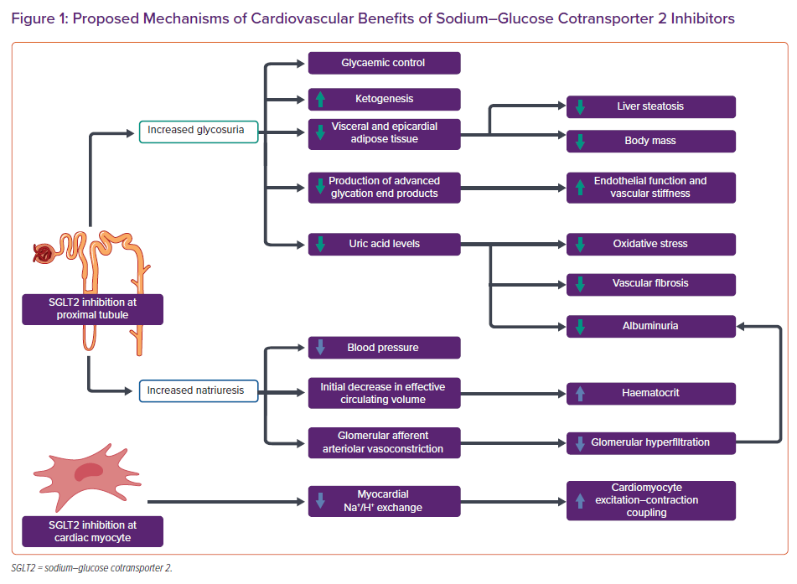
Agarwalla A, Gruen J, Peters C, Sinnenberg L, Owens AT, Reza N
Proposed Mechanisms of Cardiovascular Benefits of Sodium–Glucose Cotransporter 2 Inhibitors
Citation: Cardiac Failure Review 2022;8:e10.
https://doi.org/10.15420/cfr.2021.31

