Slide 1

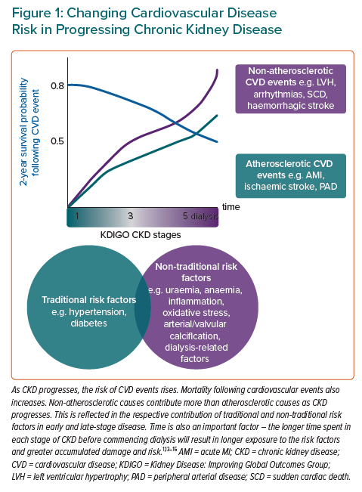
Warrens H, Banerjee D, Herzog CA
Changing Cardiovascular Disease Risk in Progressing Chronic Kidney Disease
Citation: European Cardiology Review 2022;17:e13.
https://doi.org/10.15420/ecr.2021.54

