Slide 1

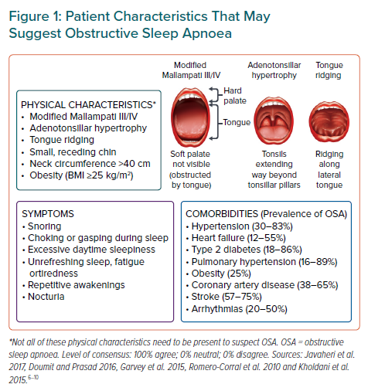
Tan JW, Leow LC, Wong S, Khoo SM, Kasai T, Kojodjojo P, Sy DQ, Lee CP, Chirakalwasan N, Li HY, Koh NSY, Tan A, Ong TH, Aung AT, Toh ST, Lee CH
Patient Characteristics That May Suggest Obstructive Sleep Apnoea
Citation: European Cardiology Review 2022;17:e16.
https://doi.org/10.15420/ecr.2021.59

