Slide 1

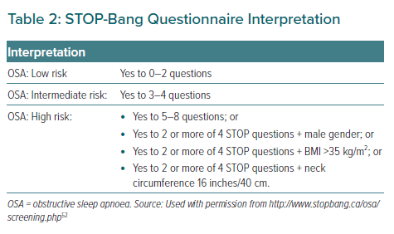
Tan JW, Leow LC, Wong S, Khoo SM, Kasai T, Kojodjojo P, Sy DQ, Lee CP, Chirakalwasan N, Li HY, Koh NSY, Tan A, Ong TH, Aung AT, Toh ST, Lee CH
STOP-Bang Questionnaire Interpretation
Citation: European Cardiology Review 2022;17:e16.
https://doi.org/10.15420/ecr.2021.59

