Slide 1

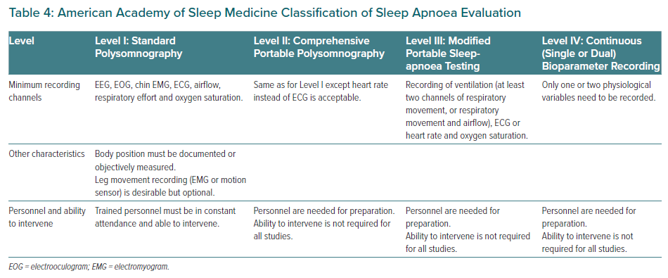
Tan JW, Leow LC, Wong S, Khoo SM, Kasai T, Kojodjojo P, Sy DQ, Lee CP, Chirakalwasan N, Li HY, Koh NSY, Tan A, Ong TH, Aung AT, Toh ST, Lee CH
American Academy of Sleep Medicine Classification of Sleep Apnoea Evaluation
Citation: European Cardiology Review 2022;17:e16.
https://doi.org/10.15420/ecr.2021.59

