Slide 1

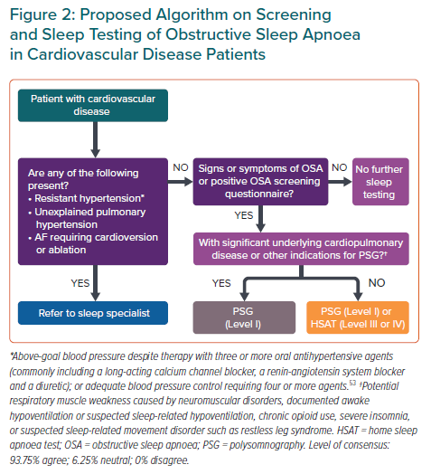
Tan JW, Leow LC, Wong S, Khoo SM, Kasai T, Kojodjojo P, Sy DQ, Lee CP, Chirakalwasan N, Li HY, Koh NSY, Tan A, Ong TH, Aung AT, Toh ST, Lee CH
Proposed Algorithm on Screening and Sleep Testing of Obstructive Sleep Apnoea in Cardiovascular Disease Patients
Citation: European Cardiology Review 2022;17:e16.
https://doi.org/10.15420/ecr.2021.59

