Slide 1

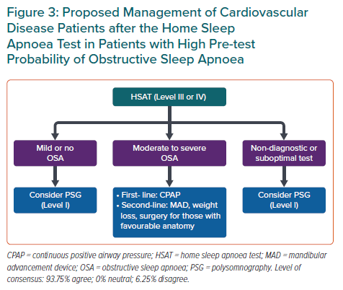
Tan JW, Leow LC, Wong S, Khoo SM, Kasai T, Kojodjojo P, Sy DQ, Lee CP, Chirakalwasan N, Li HY, Koh NSY, Tan A, Ong TH, Aung AT, Toh ST, Lee CH
Proposed Management of Cardiovascular Disease Patients after the Home Sleep Apnoea Test in Patients with High Pre-test Probability of Obstructive Sleep Apnoea
Citation: European Cardiology Review 2022;17:e16.
https://doi.org/10.15420/ecr.2021.59

