Slide 1

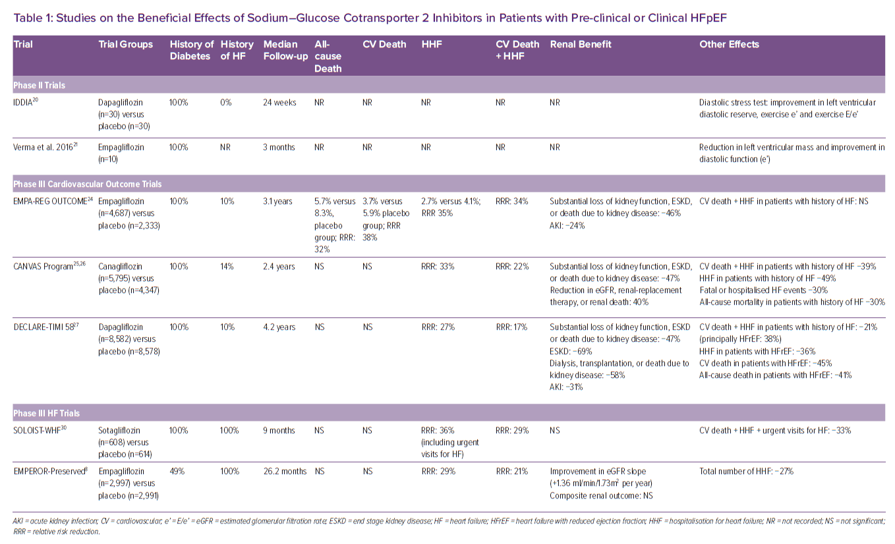
Gori M, D'Elia E, Sciatti E, Senni M
Studies on the Beneficial Effects of Sodium–Glucose Cotransporter 2 Inhibitors in Patients with Pre-clinical or Clinical HFpEF
Citation: Cardiac Failure Review 2022;8:e26.
https://doi.org/10.15420/cfr.2022.04

