Slide 1

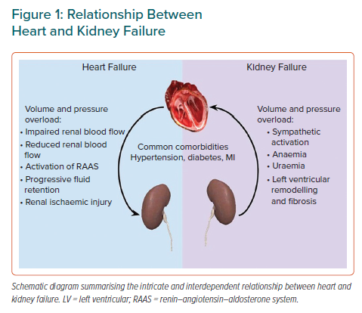
Ryan DK, Banerjee D, Jouhra F
Relationship Between Heart and Kidney Failure
Citation: European Cardiology Review 2022;17:e17.
https://doi.org/10.15420/ecr.2021.33

