Slide 1

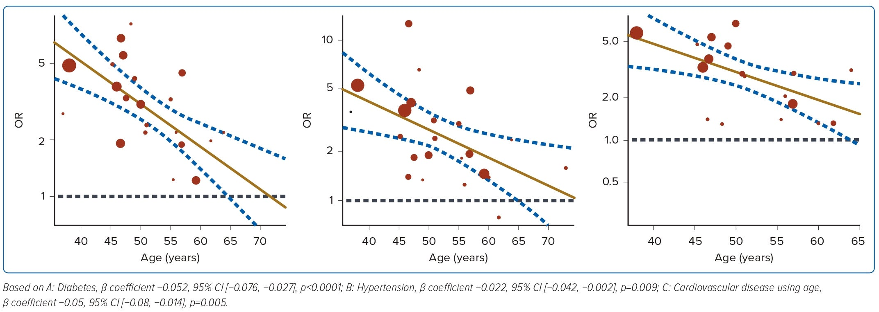
Fong RY, Lee A, Gao F, Yap JJL, Yeo KK
Figure 4: Meta-regression Analyses of Risk of Mortality
Citation: Journal of Asian Pacific Society of Cardiology 2023;2:e22.
https://doi.org/10.15420/japsc.2022.27

