Slide 1

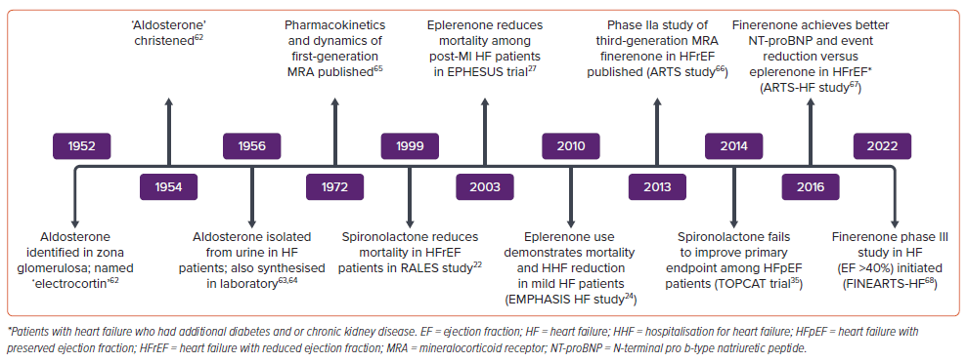
Sethi R, Vishwakarma P, Pradhan A
Figure 2: Timeline of Major Landmarks in the Journey of Aldosterone Antagonism in Heart Failure
Citation: Cardiac Failure Review 2024;10:e15.
https://doi.org/10.15420/cfr.2024.10

