Slide 1

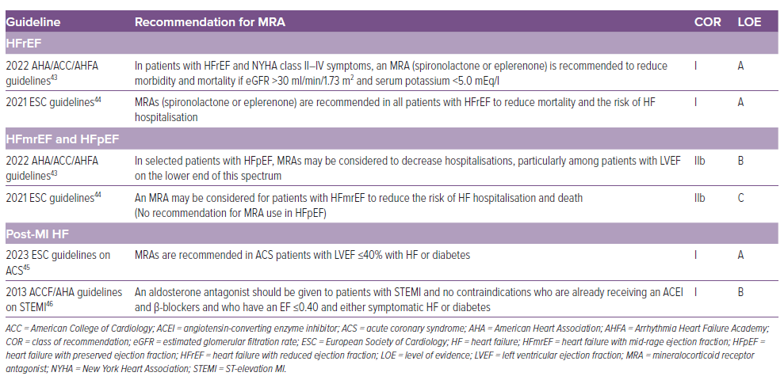
Sethi R, Vishwakarma P, Pradhan A
Table 2: Guideline Recommendations for Mineralocorticoid Antagonists
Citation: Cardiac Failure Review 2024;10:e15.
https://doi.org/10.15420/cfr.2024.10

