Slide 1

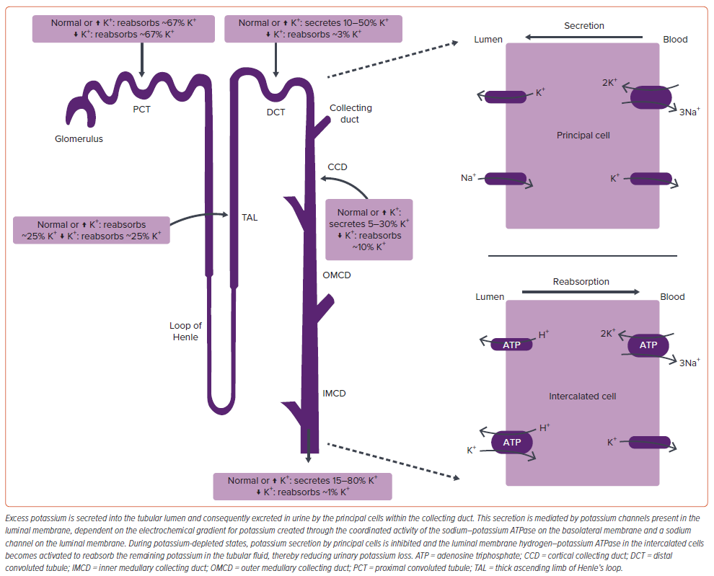
Khan LA, Jamil A, Greene SJ, Khan MS, Butler J
Figure 1: Potassium Regulation in the Nephron
Citation: Cardiac Failure Review 2024;10:e18.
https://doi.org/10.15420/cfr.2024.09

