Slide 1

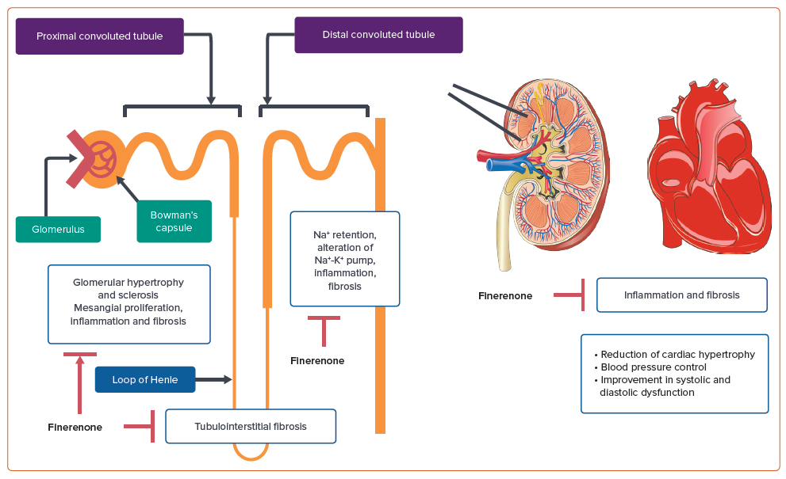
Khullar D, Gupta AK, Singh K
Figure 1: Mechanism of Action of Finerenone on the Heart and Kidneys
Citation: Cardiac Failure Review 2024;10:e19.
https://doi.org/10.15420/cfr.2024.11

