Slide 1

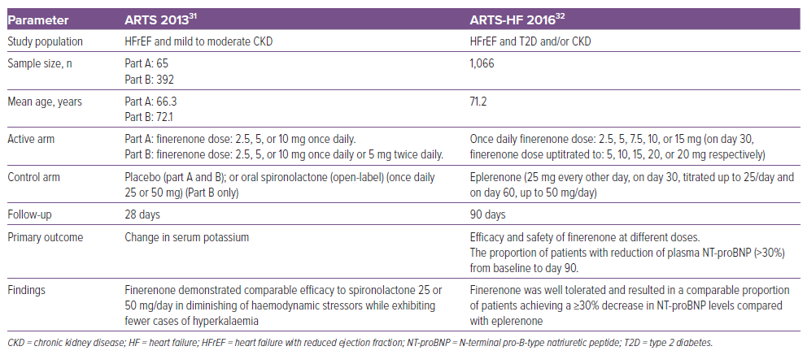
Khullar D, Gupta AK, Singh K
Table 2: Phase II Clinical Trials Evaluating the Safety and Efficacy of Finerenone in Patients with Heart Failure, Chronic Kidney Disease and/or Type 2 Diabetes
Citation: Cardiac Failure Review 2024;10:e19.
https://doi.org/10.15420/cfr.2024.11

