Slide 1

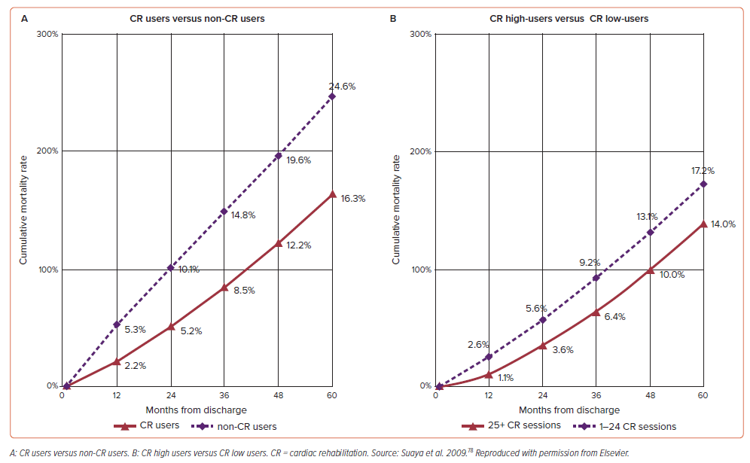
Nguyen N, Michelis KC
Figure 2: Cumulative Mortality Rates Matched for Cardiac Rehabilitation Use
Citation: US Cardiology Review 2025;19:e01.
https://doi.org/10.15420/usc.2024.34

