Slide 1

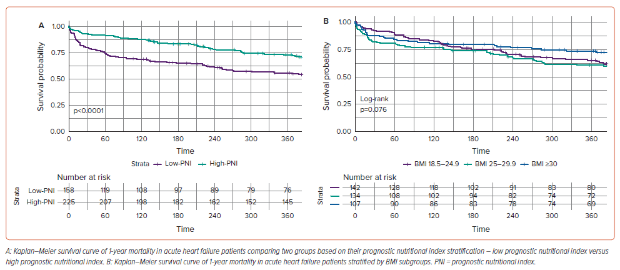
El-Sheikh M, El Caidi NO, Kandiah A, Tonning SH, Taraldsen IA, Wisborg FD, Andersen O, Hove JD, Grand J
Figure 1: Kaplan–Meier Survival Curves for 1-Year Mortality for Acute Heart Failure Patients Stratified by Prognostic Nutritional Index or BMI
Citation: Cardiac Failure Review 2025;11:e03.
https://doi.org/10.15420/cfr.2024.35

