Slide 1

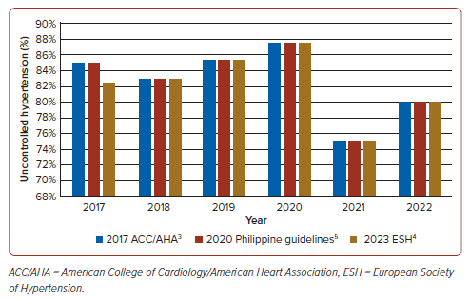
Rivera KMMO, Cuenza L
Figure 2: Percentage of Patients With Uncontrolled Hypertension Per Guideline from 2017 to 2022
Citation: Journal of Asian Pacific Society of Cardiology 2026;5:e13.
https://doi.org/10.15420/japsc.2025.103

