Slide 1

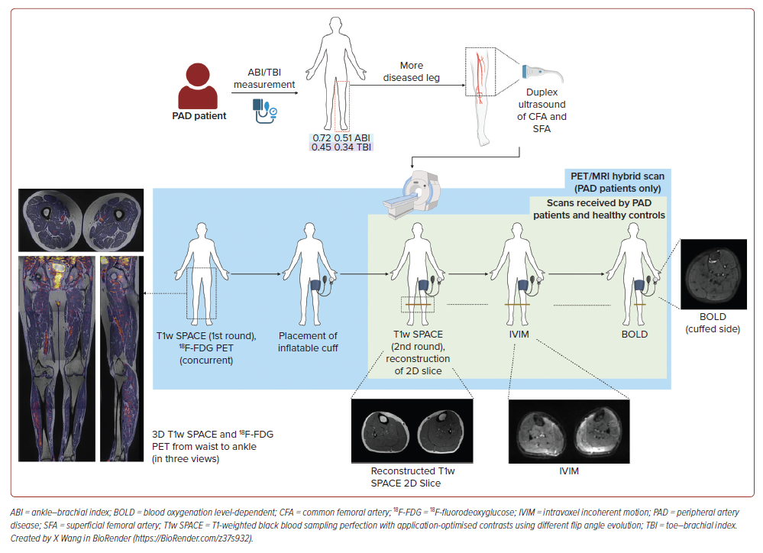
Wang X, Ying A, Ng JJ, Nai YH, Chan DYS, Chan MYY, Chong TT, Choong AM, Gan J, Gao F, Chung YC, Khong PL, Lau C, Lian CPL, Lim SL, Lo ZJ, Hausenloy DJ
Figure 1: Flow Diagram of Scans Received by Patients with Diabetes and Peripheral Artery Disease and the Healthy Controls
Citation: Journal of Asian Pacific Society of Cardiology 2026;5:e21.
https://doi.org/10.15420/japsc.2025.95

