Slide 1

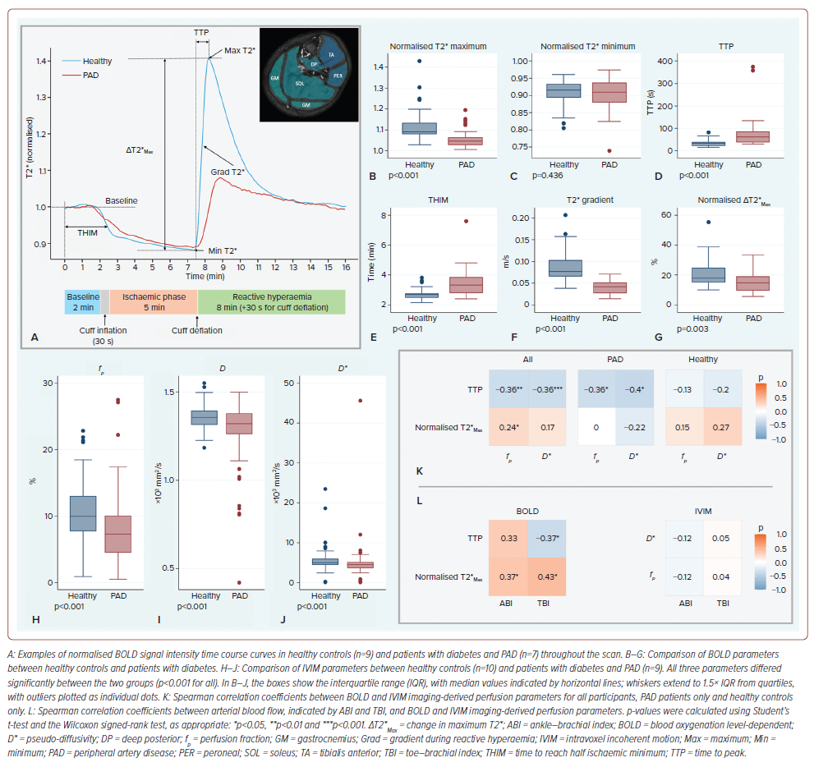
Wang X, Ying A, Ng JJ, Nai YH, Chan DYS, Chan MYY, Chong TT, Choong AM, Gan J, Gao F, Chung YC, Khong PL, Lau C, Lian CPL, Lim SL, Lo ZJ, Hausenloy DJ
Figure 2: Results of Blood Oxygenation Level-dependent Imaging, Intravoxel Incoherent Motion Imaging and Arterial Blood Flow
Citation: Journal of Asian Pacific Society of Cardiology 2026;5:e21.
https://doi.org/10.15420/japsc.2025.95

