Slide 1

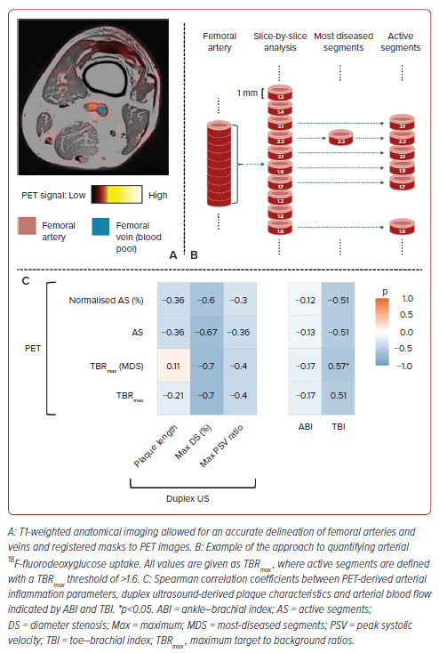
Wang X, Ying A, Ng JJ, Nai YH, Chan DYS, Chan MYY, Chong TT, Choong AM, Gan J, Gao F, Chung YC, Khong PL, Lau C, Lian CPL, Lim SL, Lo ZJ, Hausenloy DJ
Figure 3: Correlations Among MRI, Ultrasound and PET Parameters
Citation: Journal of Asian Pacific Society of Cardiology 2026;5:e21.
https://doi.org/10.15420/japsc.2025.95

