Slide 1

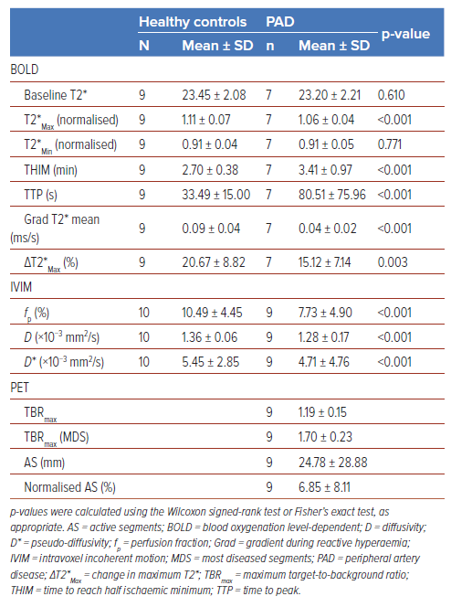
Wang X, Ying A, Ng JJ, Nai YH, Chan DYS, Chan MYY, Chong TT, Choong AM, Gan J, Gao F, Chung YC, Khong PL, Lau C, Lian CPL, Lim SL, Lo ZJ, Hausenloy DJ
Table 2: Comparison of MRI and PET Parameters Between Patients with Diabetes and Peripheral Artery Disease and Healthy Controls
Citation: Journal of Asian Pacific Society of Cardiology 2026;5:e21.
https://doi.org/10.15420/japsc.2025.95

