Slide 1

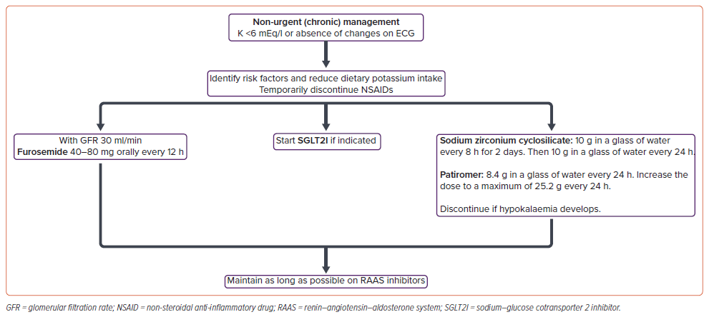
Méndez-Durán A, Ivey-Miranda JB, Mendoza-Zavala GH, Álvarez-Sangabriel A, Sánchez-Guerrero DC, Díaz-García JD, Borges-Vela JA, Morales-Buenrostro LE, Quilantán-Rodríguez M, Ruíz-Mejía R, Chávez-Leal SA
Figure 2: Flow Chart for the Management of Hyperkalaemia of Cardiorenal Origin (Non-urgent [Chronic] Management)29,30,32–36
Citation: Cardiac Failure Review 2026;12:e10.
https://doi.org/10.15420/cfr.2025.03

