Slide 1

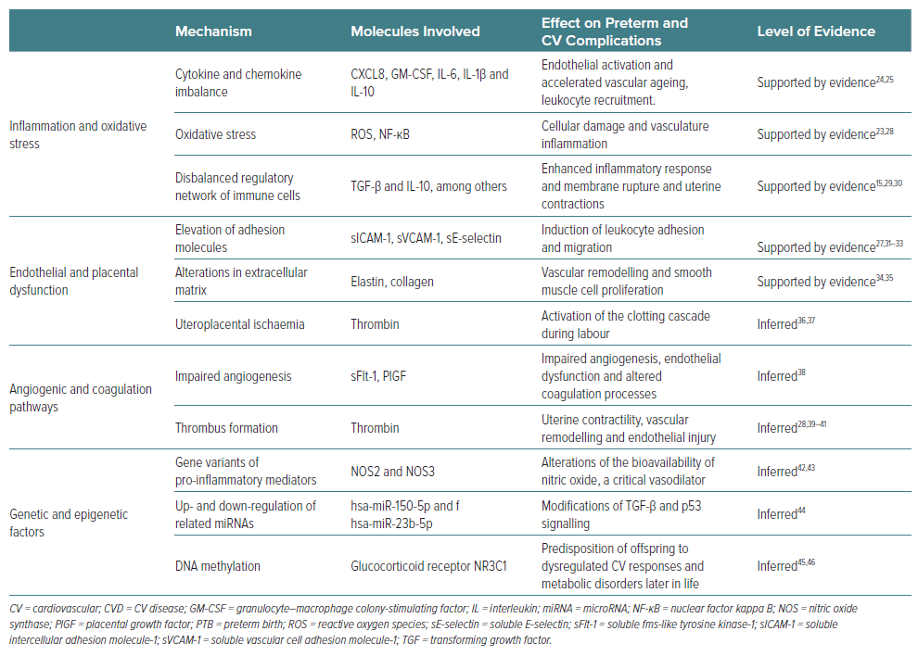
Segovia-Reyes J, Iboleon-Jimenez A, Jiménez-Salva M, Carmona-Segovia AD, Navarro MFJ, Ortega-Gomez A
Table 1: Proposed Pathophysiological Mechanisms Shared between Preterm Birth and Maternal Cardiovascular Disease
Citation: European Cardiology Review 2026;21:e24.
https://doi.org/10.15420/ecr.2025.43

