Slide 1

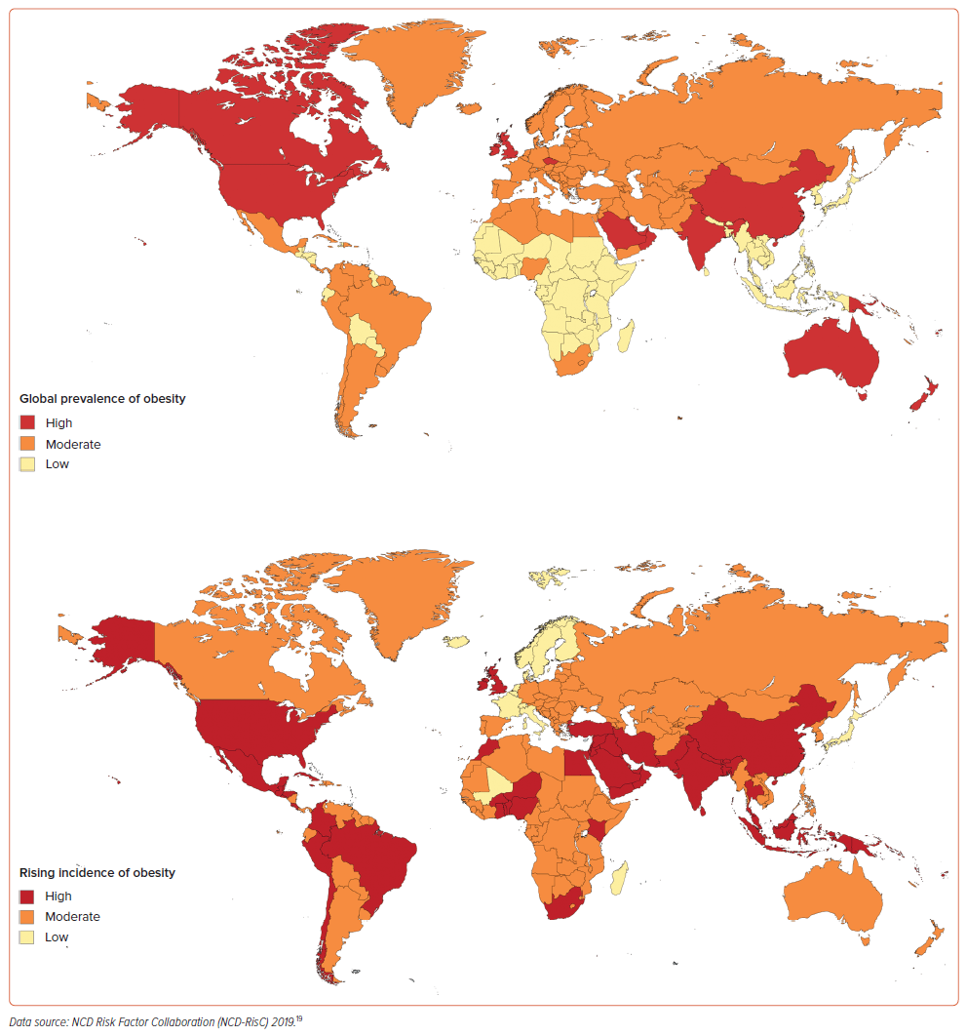
Henney AE, Wilding JP
Figure 2: Heat Maps Demonstrating the Global Prevalence and Rising Incidence of Obesity Globally
Citation: European Cardiology Review 2026;21:e25.
https://doi.org/10.15420/ecr.2025.84

