Slide 1

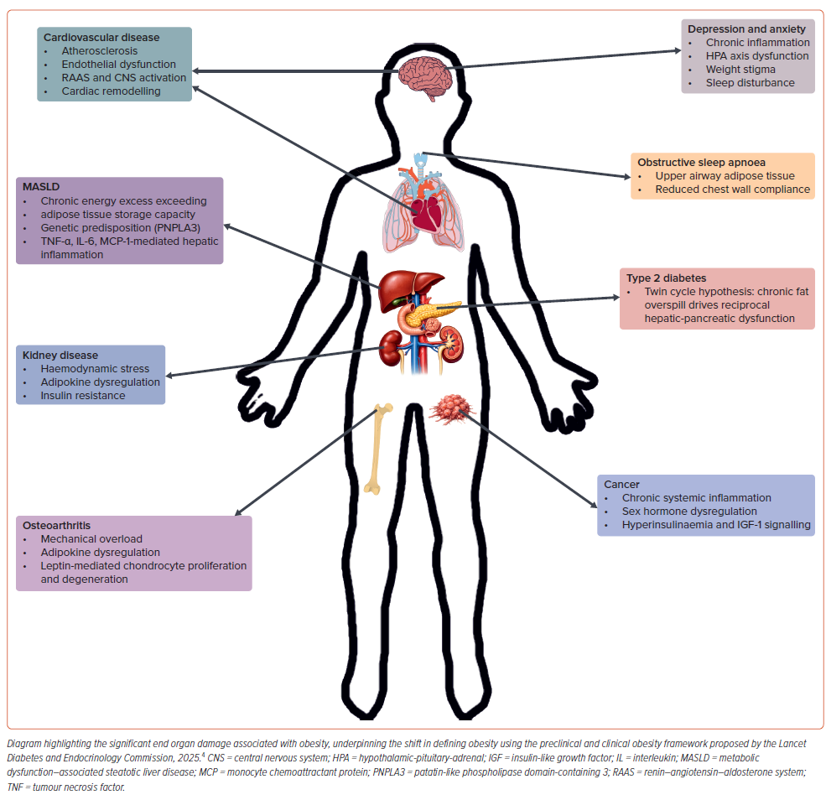
Henney AE, Wilding JP
Figure 3: End Organ Damage Associated with Excess Adiposity
Citation: European Cardiology Review 2026;21:e25.
https://doi.org/10.15420/ecr.2025.84

