Slide 1

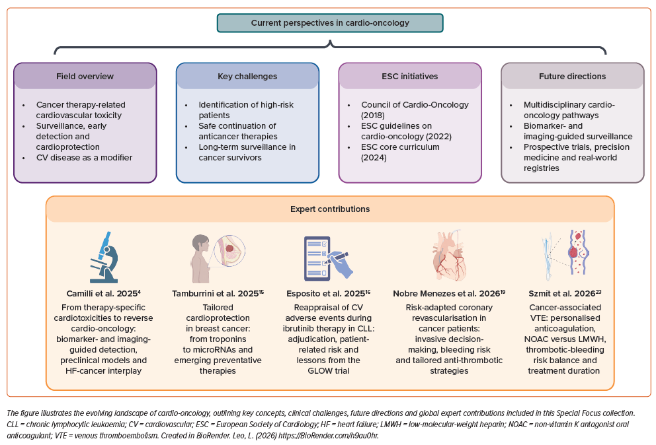
Leo L, Camilli M
Figure 1: Key Concepts and Expert Contributions in Cardio-oncology
Citation: European Cardiology Review 2026;21:e26.
https://doi.org/10.15420/ecr.2026.22

